Slide 1
TEXT SUMMARIZATION
BY :-
ADITI PARAB
ANUJA YADAV
ANIKET MALI
MAYUR MAPARI
HEMANG SINGH
NIRAJ PALVE
MENTOR :- MUNMUN MA’AM DATE :- 31 / 05 / 2022

Slide 2
BUSINESS PROBLEM :-
To present a shorter version of the original text while preserving the semantics using different traditional and advanced methods to implement automatic text summarization, and then compare the results of each method to conclude which is the best to use for corpus.
OBJECTIVE :-
The main objective of a text summarization system is to identify the most important information from the given text and present it to the end users. The text is first pre-processed to tokenize the sentences and perform stemming operations. We then score the sentences using the different text features. These features along with the traditional methods are used to score the sentences. The scores are used to classify the sentence to be in the summary text or not with the help of a neural network. The user can provide what percentage of the original text should be in the summary. It is found that scoring the sentences based on citations gives the best results.

Slide 3
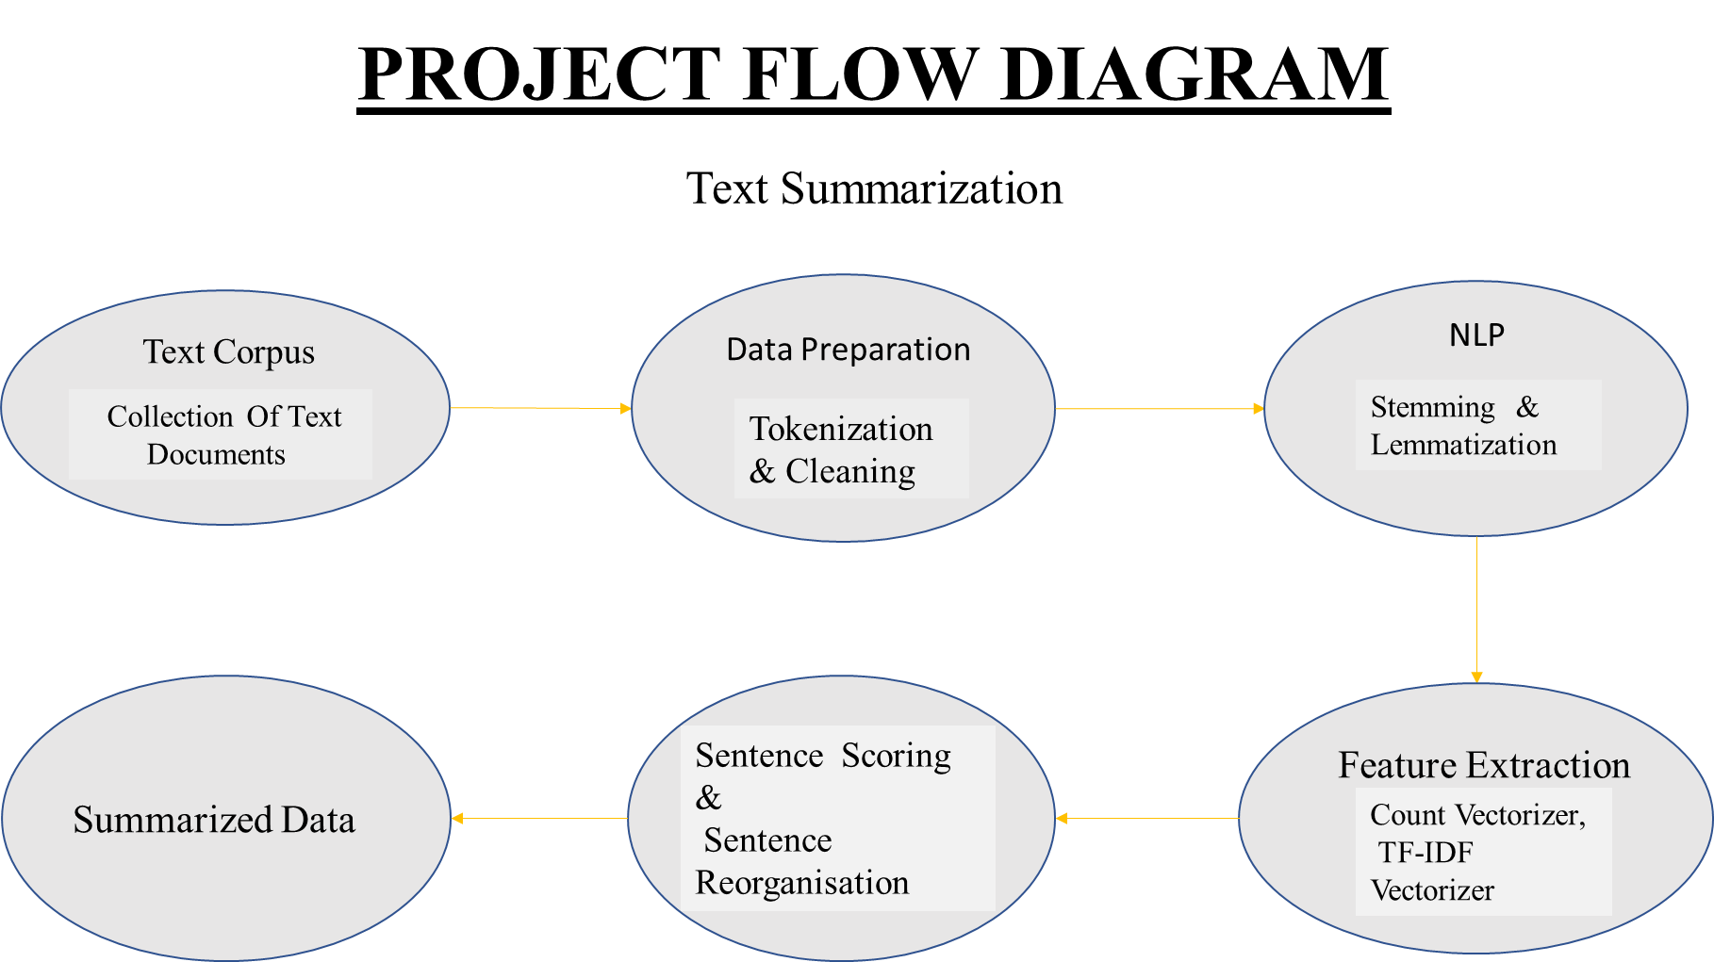

Slide 4
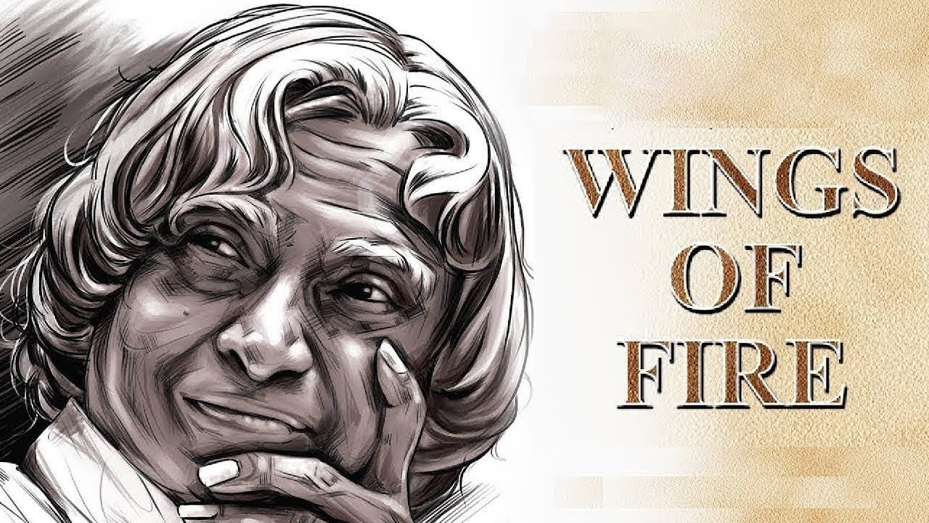
DATA INFORMATION
Textbook name :- Wings of fire
Author :- Dr.APJ Abdul Kalam
Source :- Google

Slide 5
EDA is the basic step of the project for Exploratory Data Analysis. Before performing operations on the data, we need to clean the data.
In text mining, EDA is done to remove the stopwords and punctuations in the data.
Text mining EDA architecture consist of followings steps-
1) Tokenization
2) Stopwords Removal
3) Punctuation Removal
4) Stemming
5) Lemmatization
EXPLORATORY DATA ANALYSIS (EDA)

Slide 6
Tokenization is the 1st step of EDA.
Tokenization is used to divide the text data into words or sentences.
Tokenization is done by two ways:-
a) Word based tokenization
b) Sentence based tokenization
We tokenized our data in the form of Word based tokenization.
We are using the NLTK library of python.(Natural Language Toolkit)
ie.from nltk.tokenize import TweetTokenizer
TOKENIZATION

Slide 7
For data processing data should be cleaned so we need to remove the punctuations from the data.
Punctuations:-Punctuations are often unnecessary as it doesn’t add value or meaning.
Punctuations are removed with the help of following function.
no_punc_text = df_Observations_text.translate(str.maketrans(“, ”,
string.punctuation))
no_punc_text
PUNCTUATIONS REMOVAL

Slide 8
Stopwords:-Stopwords are most common words in any language that do not carry any meaning and are usually ignored by NLP.
So we need to remove it to process our data
Examples of stopwords are as following:-
A,AN,THE,ARE,OF,AND, ETC….
Stopwords are removed by using following function in Python.
from nltk.corpus import stopwords
STOPWORDS REMOVAL

Slide 9
Feature extraction techniques are used to convert text into a matrix
Or vector of features.
It assigns different weights to words.
Types of Feature extraction techniques are as follows~
1)Bag of words(BOW)
2)TF-IDF
3)Word Embedding
FEATURE EXTRACTION TECHNIQUE

Slide 10
Stemming and lemmatization both are text reduction techniques.
By using stemming and lemmatization we reduced the text size.
So our model is not considering two different meaning of the same word.
It means the suffix and prefix of the word is removed by maintaining the semantic of the word.
Example:-
Playing, played is consider as Play
Following function is used for lemmatization
from nltk.stem import PorterStemmer
STEMMING & LEMMATIZATION

Slide 11
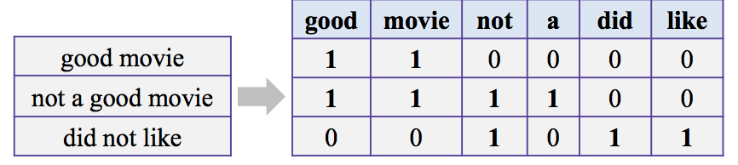
BOW is the simple representation of the words.
Representation of text describes the occurrence of words within
the document.
Generally it counts the frequency of words thats are repeated in
The given document.
Function used for this in python is
from sklearn.feature_extraction.text import CountVectorizer
Example:-
BAG OF WORDS(BOW)

Slide 12
TF-IDF stands for Term frequency-inverse document frequency
TF calculates the frequency of the word in given document divided
By the total words in the document
eg.TF=No.of word in document/Total No.of words in document
IDF calculate the frequency of words in the total documents.
IDF=Total no. of documents/no.of documents with word in it
Weight=Tf*IDF
So in this way weights are assigned to the words & is more semantic than the BOW.
Higher weight is assigned to the most repetitive word so it is considered as less significant.
TF-IDF

Slide 13
Both BOW & TF-IDF approach semantic information is not stored.TF-IDF gives importance to uncommon words.
They cannot capture the semantics of the sentences.
So the solution is Word embedding.
LIMITATIONS OF BOW & TF-IDF

Slide 14
Word embedding is term used for the representation of the word for text analysis.
The most used type of word embedding is Word2Vec.
In this model each word is basically represent as vector of 32
Or more dimension instead of the single word.
Here,semantic information & relation between word is also preserved.
Eg.
The wife is always supporting to his husband.
The queen is always supporting to king.
So,here Wife & queen get nearby vector, king & man also get nearby vector.
Based on a gender class.
So in this way semantic is maintaining.
WORD EMBEDDING

Slide 15
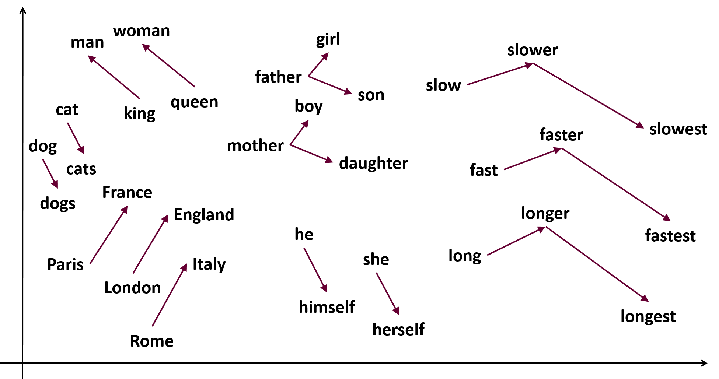
Word2vec assigns the nearby vector according to the class.
Function used for this in python is:-
from gensim.models import Word2Vec

Slide 16
In our case we used pretrained models for book summarization and they are as follow
Lex rank
Luhn model
LSA model
Text rank
BERT model
MODEL BUILDING

Slide 17
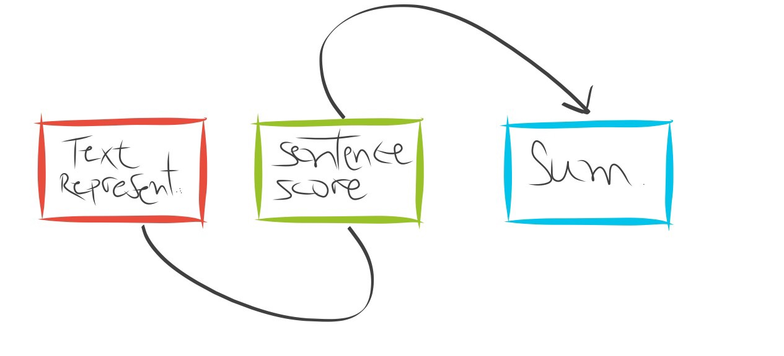
Text summarization are of two types as defined
Extractive text summarization:-
Extractive summarization picks up sentences directly from the document based on a scoring function to form a coherent summary. This method work by identifying important sections of the text and crops out and stitches together portions of the content to produce a condensed version
eg.Text Rank,Luhn,LexRank,lsa etc.
TEXT SUMMARIZATION

Slide 18
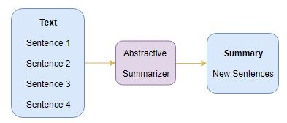
Abstractive text summarization:-
Abstractive summarization methods aims at producing summary by interpreting the text using advanced natural language techniques in order to generate a new shorter text — parts of which may not appear as part of the original document.
Abstractive text summarization generates text with respect to the surrounding text.
It is advanced type of text summarization.
eg.LSTM,RNN,BERT,Transformer
BART,etc.

Slide 19
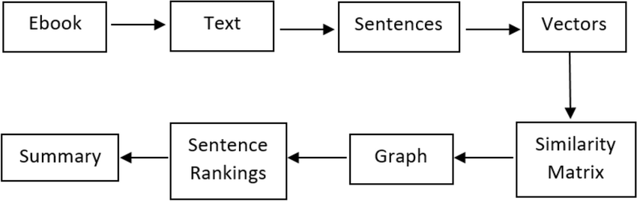
LexRank is an unsupervised graph based approach for automatic text summarization.
In this model,we have a connectivity matrix based on intra-sentence cosine similarity which is used as the adjacency matrix of the graph representation of sentences
With the help of cosine similarity scored sentences are extracted from the document and are arranged in order.
LEX RANK

Slide 20
Luhn’s algorithm is a naive approach based on TF-IDF and on “window size” of non-important words and between words of high importance.
It also assigns higher weights to sentences occurring near the beginning of a document.
It is useful when very low frequent words as well as highly frequent words(stopwords) both are not significant.
Based on this, sentence scoring is carried out and the high ranking sentences make it to the summary.
The syntax for Luhn summarizer is
from sumy.summarizers.luhn import LuhnSummarizer
luhn_summarizer=LuhnSummarizer()
LUHN TEXT SUMMARIZATION

Slide 21
Latent Semantic Analysis is an unsupervised learning algorithm that can be used for extractive text summarization.
It extracts semantically significant sentences by applying singular value decomposition(SVD) to the matrix of term-document frequency.
The syntax used in python is
from sumy.summarizers.lsa import LsaSummarizer
lsa_summarizer=LsaSummarizer()
LSA TEXT SUMMARIZATION

Slide 22
TextRank uses an extractive approach and is an unsupervised graph-based text summarization technique.
PageRank is an algorithm used to calculate rank of web pages, and is used by search engines such as Google.
TextRank is based on the PageRank Algorithm.
It finds the similarities between sentences and then organizes in descending order.
The following syntax used for the text rank summary in python
from sumy.summarizers.text_rank import TextRankSummarizer
text_summary=TextRankSummarizer()
TEXT RANK

Slide 23
BERT (Bidirectional transformer) is a transformer used to overcome the limitations of RNN and other neural networks for Long term dependencies
BERT is the type of abstractive summarization.
Its generates the text accordingly to the nearby sentences.
It is a pre-trained model that is naturally bidirectional.
The libraries used in python for BERT model is TRANSFORMERS & BERT EXTRACTIVE SUMMARIZER.
BERT TEXT SUMMARIZATION

Slide 24
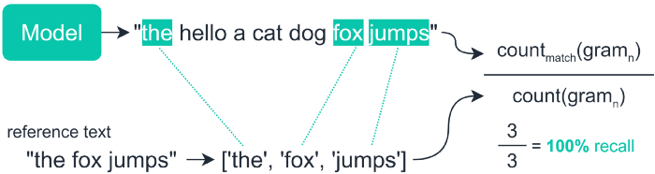
MODEL’S EVALUATION
ROUGE-N MEASURE
ROUGE Measure the number of common N-grams between the generated summary & The original Text.
With the help of this we measure PRECISION, RECALL & F1-Score
Example:-

Slide 25
MODEL EVALUATION RESULT
Conclusion:-
In our evaluation BART & BERT Model gives high F1-score so we choose this models for deployment.
 | Score | Lex Rank | Text Rank | Luhn | LSA | GPT2 | BART | BERT
1 | Recall | 0.09266 | 0.06921 | 0.08852 | 0.1 | 0.077 | 0.28 | 0.28
2 | Precision | 1.0 | 1.0 | 1.0 | 1.0 | 1.0 | 0.99 | 0.99
3 | F1 | 0.1696 | 0.1296 | 0.1626 | 0.1626 | 0.1444 | 0.44 | 0.44

Slide 26
MODEL DEPLOYMENT
With the help of ROUGE score we choose our BERT model for the deployment.As BERT model gives high F1-Score i.e 0.45
We deployed our model with the help of streamlit.
Streamlit is an open-source app framework for creating and deploying data science applications.
It is easy to operate.
We deploy our model in anaconda prompt
We use following function in anaconda prompt
Streamlit run app.py

Slide 27
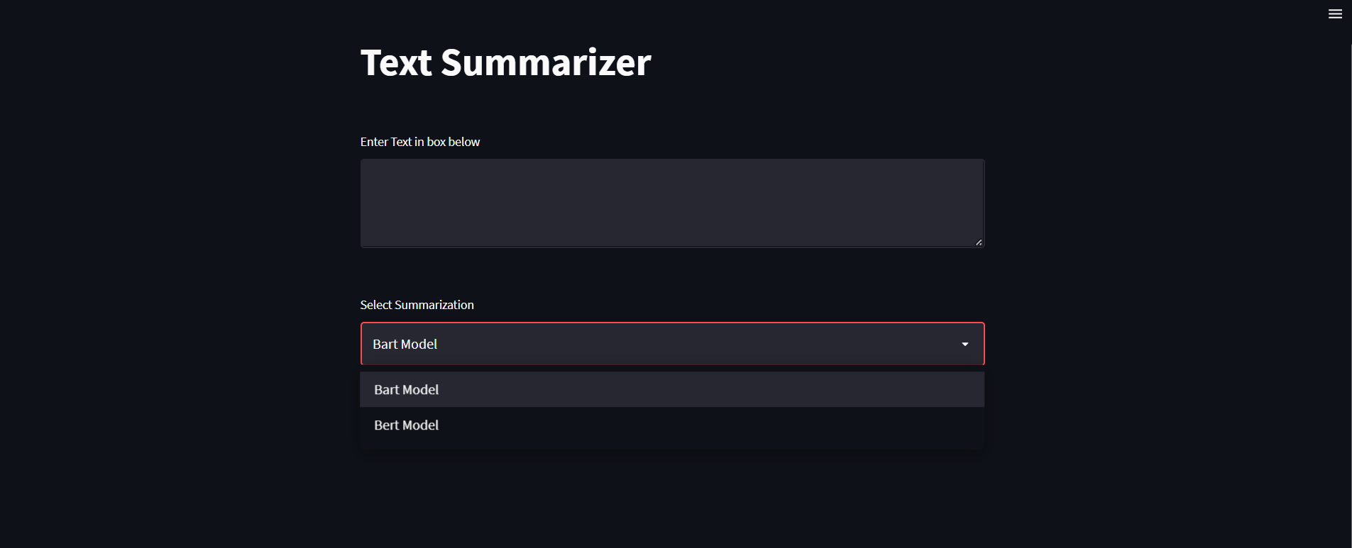
MODEL DEPLOYMENT

Slide 28
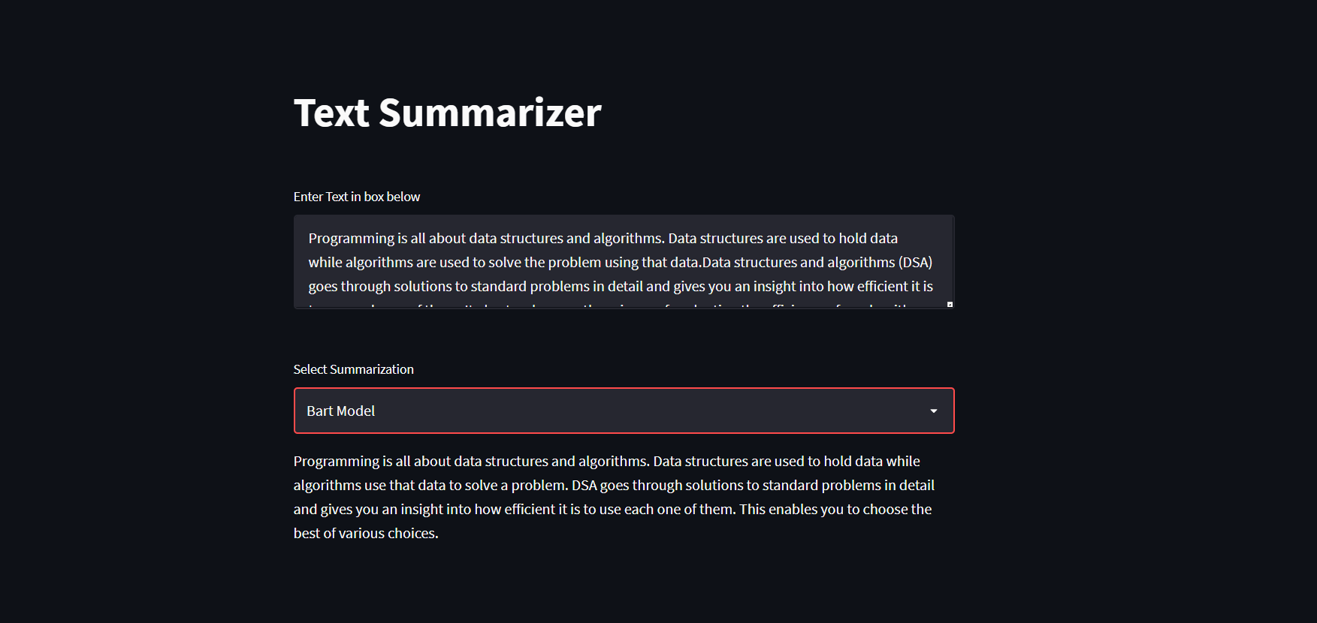
MODEL DEPLOYMENT

Slide 29
CHALLENGE’S FACED
Faced difficulties while extracting chapters of book from entire dataset.
Faced some difficulties while implementing abstractive models like Bert, Bart and GPT2.
Unable to decide whether which model gives better accuracy and which model to take for deployment.
Faced issues while deployment of models.

Slide 30
HOW WE OVERCOME CHALLENGE’S
Successfully run models by installing modules like Pytorch, Transformers.
Decided best model for deployment by performing model evaluation techniques like Rouge.
Deployed a model using streamlit as it is easier than flask, Django.

Slide 31


